Slide 1

FastAI Tech Talk
Dustin VanStee - Data Scientist
Bob Chesebrough -Data Scientist
AI Center of Competency
IBM Worldwide Client Experience Centers
AI Immersion

Slide 2

a few words on FastAI Cofounder Jeremy Howard

Slide 3
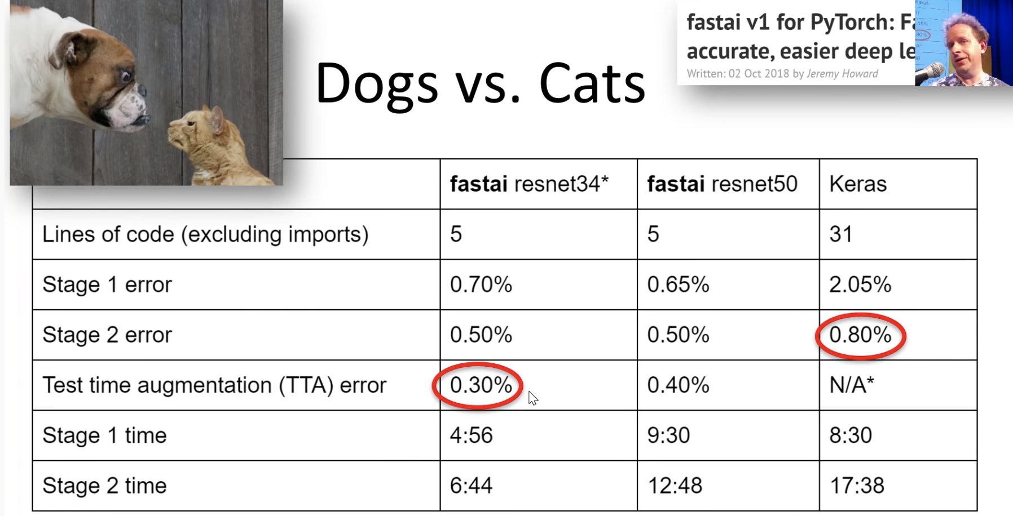
What is FastAI?
Deep Learning Framework built on top of PyTorch
Incorporates best practices learned from experts (training / simplicity)
Easy to use examples
World class results!
Flexibility to extend to custom problems
Built on top of PyTorch framework
Vibrant user community
Excellent educational material
videos : https://course.fast.ai/
repo : https://github.com/fastai/course-v3
Notes:
learning leverages a top down approach. get results relatively quickly, and then peel back the onion successively for more and more understanding

Slide 4
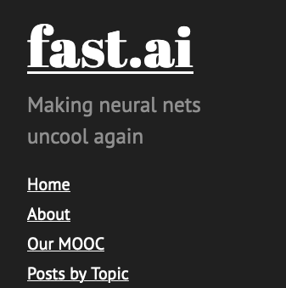
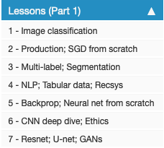
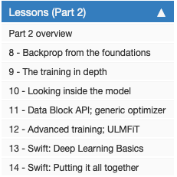
Notes:
udner a lot of development

Slide 5
FastAI 101 - Agenda
FastAI Concepts
Databunch
Learner
LRFind /One Cycle Learning
Transfer Learning
Interpretation

Slide 6
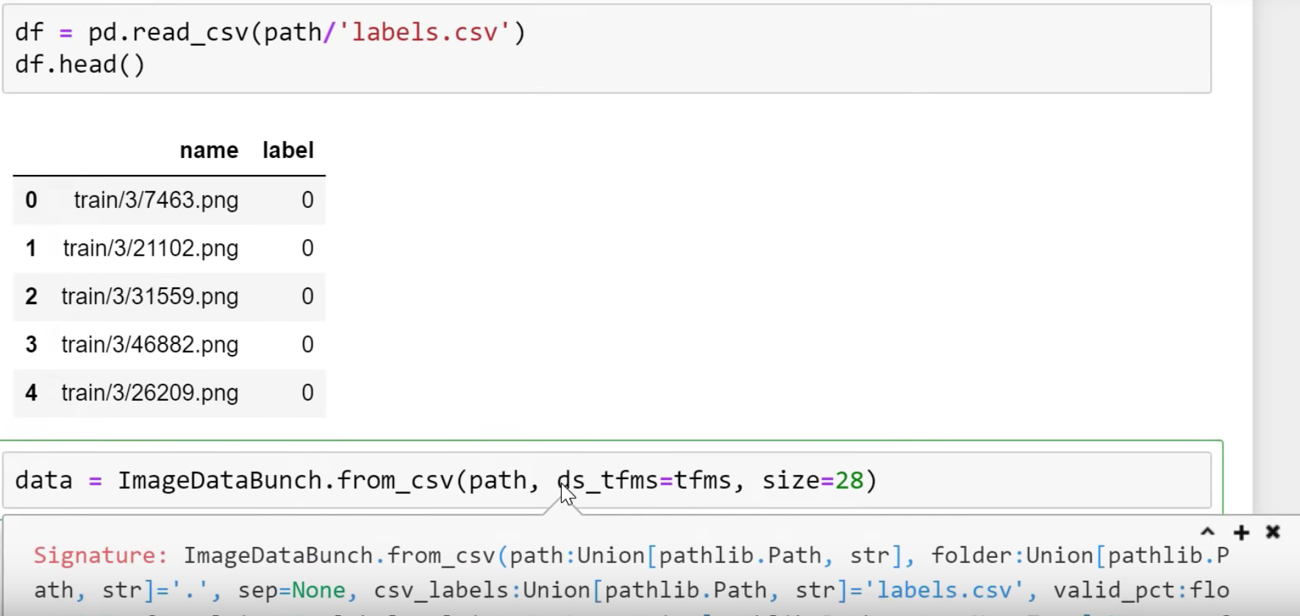
FastAI Concepts – Databunch
Abstraction that helps manage train / validation datasets
Supports all types of data (Image / text / tabular)
Flexible to support meta data files that contain labels
Notes:
common framework for all data types // text // image // tabular ..
leverages datablock API

Slide 7
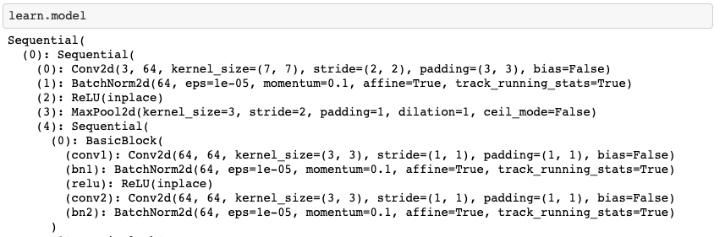
FastAI Concepts – Learner
Learner is fastAI abstraction that holds the neural network architecture and the methods to train it
Notes:
cnn learner
tabular learner
language modle learner
classifiers ...

Slide 8
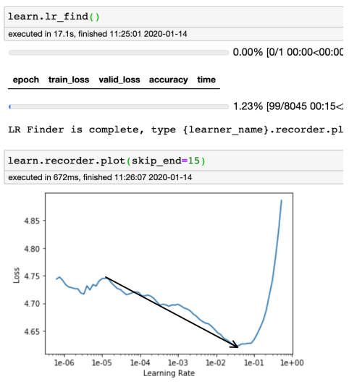
FastAI Concepts – Learning Rate Find
According to Jeremy Howard the most important hyper-parameter to tune of any NN model is the learning rate. FastAI implements an lr find algorithm that steps through different learning rates and plots losses. For detailed information look here https://sgugger.github.io/how-do-you-find-a-good-learning-rate.html
This method is somewhat empirical, but in practice works very well.
Goal on any plot is to find the longest downward slope and use thes as bounds for fit one cycle

Slide 9
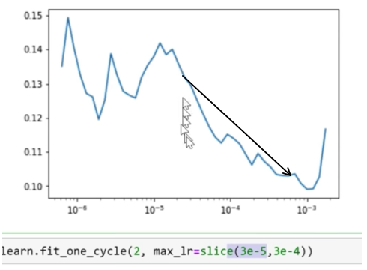
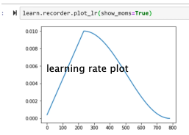
FastAI Concepts – One Cycle Learning
Traditional training methods use a fixed learning rate or learning rate schedules to find a decent solution to the NN optimization problem. Issues here the speed at which you find the minimum, and how close the local minimum is to global minimum.
Fit one cycle takes a different approach. They sweep learning rates as show above right to find optimal solution. Why does this work ? -> (https://arxiv.org/abs/1506.01186)
Notes:
An intuitive understanding of why CLR methodswork comes from considering the loss function topology.Dauphinet al. [4] argue that the difficulty in minimizing theloss arises from saddle points rather than poor local minima.
Saddle points have small gradients that slow the learningprocess. However, increasing the learning rate allows morerapid traversal of saddle point plateaus. A more practicalreason as to why CLR works is that, by following the meth-ods in Section 3.3, it is likely the optimum learning rate willbe between the bounds and near optimal learning rates willbe used throughout traini
in other words the small LR starts us in the right direction and continual growing accelerates us in right direction, until point where we need to decay to stabilize...
Faster convergence and better training results are the end product of the algorithm and its what FastAI implements

Slide 10
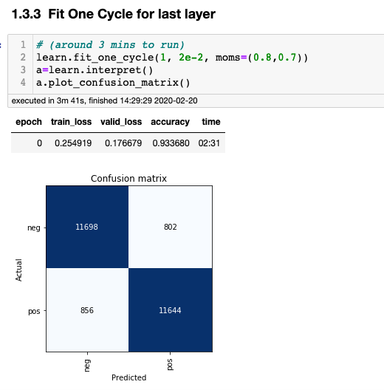
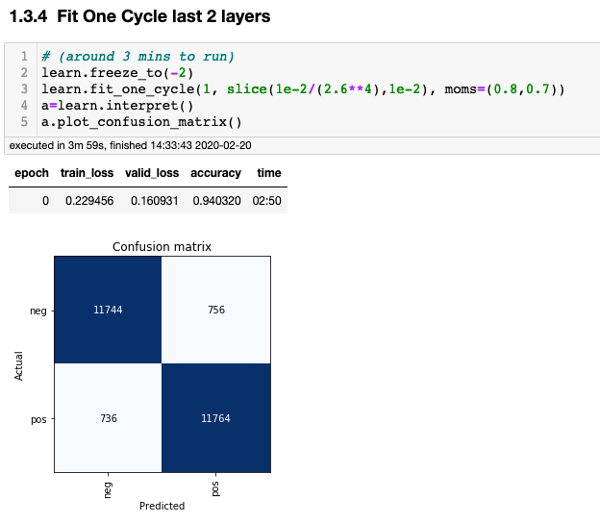
FastAI Concepts – Transfer Learning / Unfreeze layers
FastAI leverages transfer learning for most of its examples, and employs a couple of other tricks along the way. One example of this is layer unfreezing ...
NLP example showing successive layer “unfreezing” – provides incrementally better accuracy

Slide 11
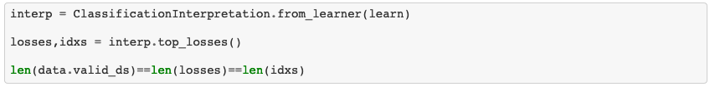
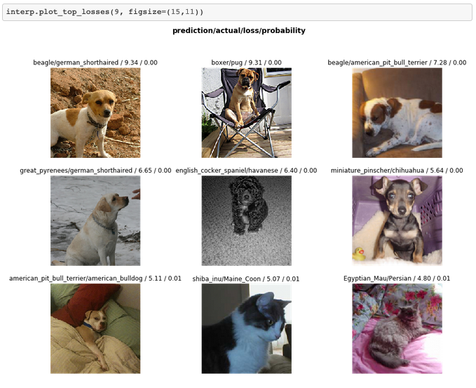
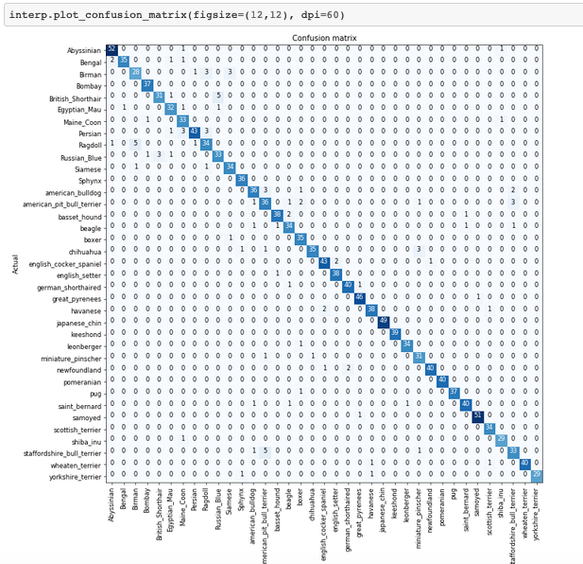
FastAI Concepts – Plot Top Losses / Confusion Matrix

Slide 12
NLP 101 – Sentiment Analysis
Using natural language to classify
sentiment analysis using IMDB
-- apply xfer learning with wiki text 103
build a language model first
-- language model (being able to predict the next word probablistically
-- then tune using IMDB corpus
-- finally classify!
Notes:
(add commentary on how IBM power can accelerate usage of pytorch)

Slide 13
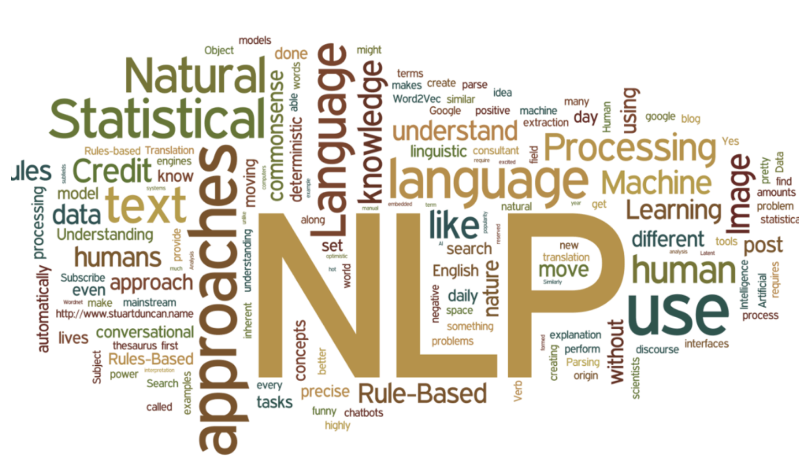
NLP Use Cases
Classical Method Used
Naive Bayes
SVM
Logistic Regression
Tree Methods
Uses
Sentiment Analysis
Document classification
Spam filtering
Topic modelling
Word Embeddings
The issue with these methods is that they don’t know anything about the English language!
Can we apply large data, transfer learning and deep learning neural networks in this space ??
YES!

Slide 14
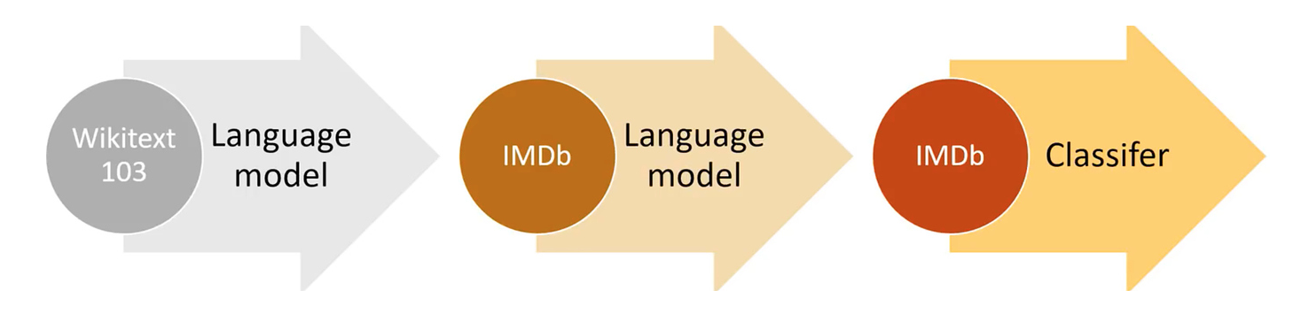
Transfer Learning with NLP – motivating example
MovieLens dataset
Contains movie ratings data from users
100k ratings
The issue here is that there isn’t enough data to sufficiently learn language subtleties
What if we first train NN to “learn” english semantics using a much larger corpus of data (like wikipedia) ?
Then ”fine tune” language model with our data ..
Then take the knowledge [embeddings] from the language and use for classification

Slide 15
Language Model Data
The goal of the language model is for the model to predict the next word ...
In this case the “target” variable in a corpus of documents is just the next word in the sentence
To build this model, fastAI employs the AWD-LSTM implementation
Today is a hot “.....”
I am going to eat a hot “.....”

Slide 16
NLP -Preprocessing
Tokenization to Numericalization
The process of taking a sentence and splitting it into words.
Also includes handling of unknown words, contractions, upper case, repeated words and so forth

Slide 17
NLP – Whats an embedding
example : 10000 word dictionary
select encoding dimension ~ 50
create an index for each word in the corpus eg. a-1, add-2, addendum-3 ....
encode each word as a one hot vector and build a NN
shortcut due to one hot implementation allows us to represent each word as a direct lookup into embedding matrix
Word Index
0 1 ... 49
a
add
addendum
..
..
..
zap
zebra
zero
0
1
2
..
..
..
9997
9998
9999
...
Diagram of Embedding matrix
Notes:
mention... whats interesting here is that embeddings encode semantic infromation!

Slide 18
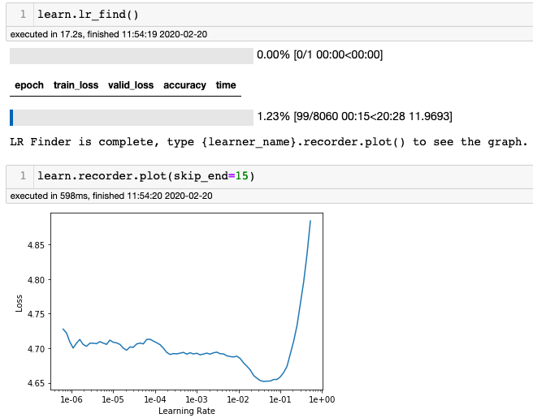
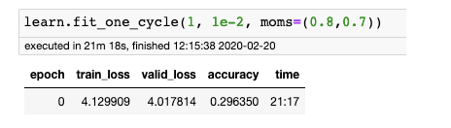
Language Model Training using fit_one_cycle
Notes:
mention... whats interesting here is that embeddings encode semantic infromation!

Slide 19
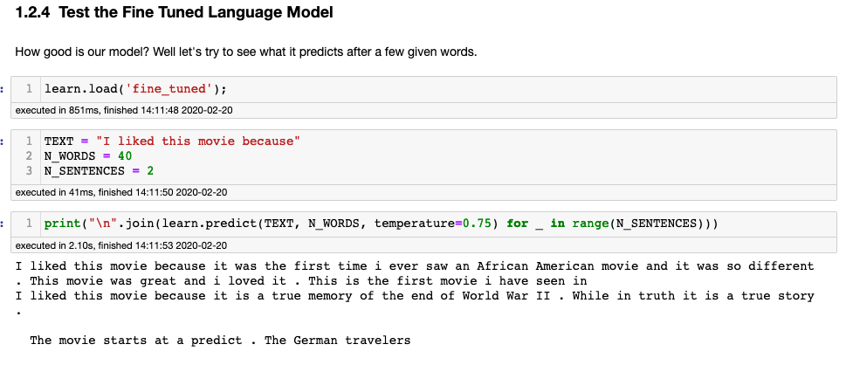
Language Model : Test it ...

Slide 20
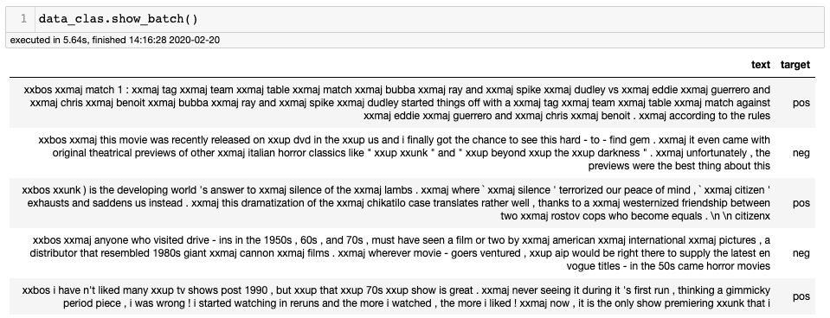
Classifier Model Data
The goal of the classifier model is to use the description to predict the target. This model also leverages the AWD_LSTM model, but in a slightly different method. Instead of trying to predict the next word, its just trying to make a classification.
To build this model, fastAI employs the AWD-LSTM implementation
Notes:
mention... whats interesting here is that embeddings encode semantic infromation!

Slide 21
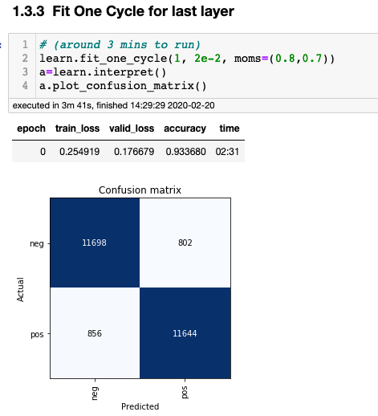
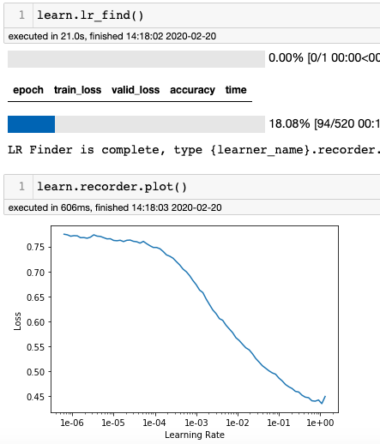
Classifier training using fit_one_cycle

Slide 22
FastAI Concepts – Put it all together with a demo!

Slide 23
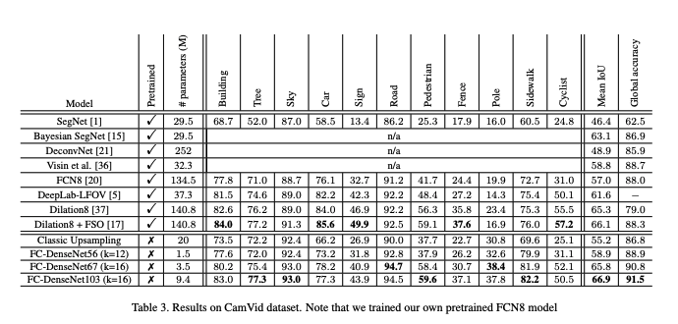
Main Idea for Fastai
Create wrappers around common operations for data and models
Implement a common learning scheme that quickly finds close to state of the art results
For image segmentation: here is the paper describing the original U-Net model for biological samples
https://arxiv.org/pdf/1611.09326.pdf
Installation via simple pip or conda:
https://docs.fast.ai/install.html
conda install -c pytorch -c fastai fastai
Our model results will generally come close to or else outperform the original authors

Slide 24
What is segmentation?
Semantic Segmentation: Parsing thru each pixel of an image and assigning that pixel to one of a finite classes
The classes are typically labelled according to identifiable objects a client cares about inside each image
Examples could include: pedestrians, sports balls, sports players, buildings, roads, or any such item that you wish to count, locate, determine extent or area
Example: Images containing bicycle crossing sign, pedestrians, buildings, sidewalks, etc
Image
Segmentation labels

Slide 25
The main idea?
Figure put a labeling scheme that is not too laborious (people have already figured out a pretty good way) to label each pixel in an image
Loop thru each pixel in an image and classify it according to the labeling scheme
Easy right?
Explanation of labeling scheme:
Allow a human editor to “paint” over an image using different colors – one for each item of interest in an image
Use the painted image as a template or mask. Each color will also be associated with a text file – sort of an index – that specifies which color is which kind of class
['Animal', 'Archway', 'Bicyclist', 'Bridge', 'Building', 'Car', 'CartLuggagePram', 'Child', 'Column_Pole', 'Fence', 'LaneMkgsDriv', 'LaneMkgsNonDriv', 'Misc_Text', 'MotorcycleScooter', 'OtherMoving', 'ParkingBlock', 'Pedestrian', 'Road', 'RoadShoulder', 'Sidewalk', 'SignSymbol', 'Sky', 'SUVPickupTruck', 'TrafficCone', 'TrafficLight', 'Train', 'Tree', 'Truck_Bus', 'Tunnel', 'VegetationMisc', 'Void', 'Wall']

Slide 26
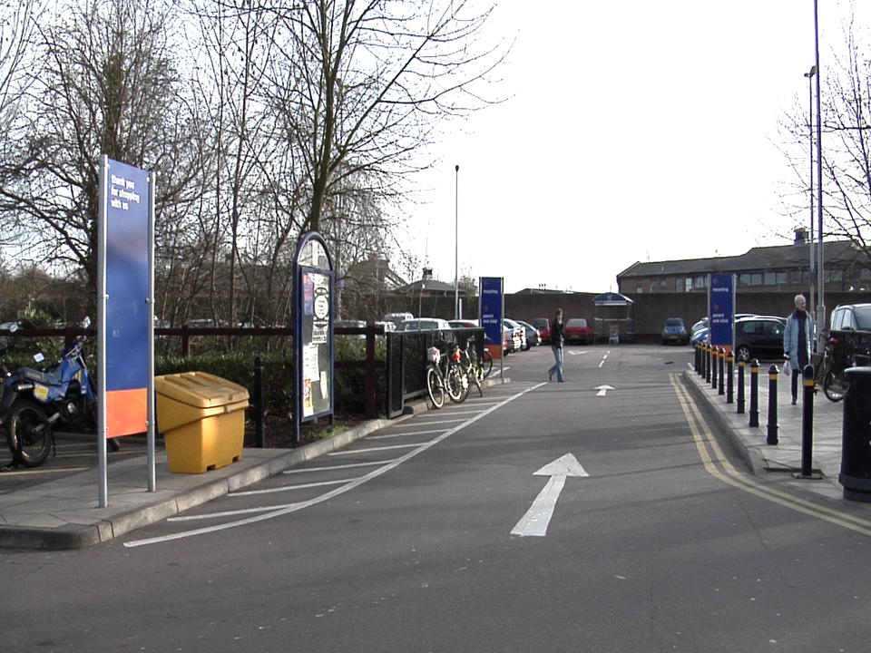
Datasets
/gpfs/home/s4s004/racheseb/.fastai/data/camvid/
PosixPath('/gpfs/home/s4s004/racheseb/.fastai/data/camvid/labels’),
PosixPath('/gpfs/home/s4s004/racheseb/.fastai/data/camvid/images’),
PosixPath('/gpfs/home/s4s004/racheseb/.fastai/data/camvid/codes.txt’),
PosixPath('/gpfs/home/s4s004/racheseb/.fastai/data/camvid/valid.txt')
Images
Labels
['Animal', 'Archway', 'Bicyclist', 'Bridge', 'Building', 'Car', 'CartLuggagePram', 'Child', 'Column_Pole', 'Fence', 'LaneMkgsDriv', 'LaneMkgsNonDriv', 'Misc_Text', 'MotorcycleScooter', 'OtherMoving', 'ParkingBlock', 'Pedestrian', 'Road', 'RoadShoulder', 'Sidewalk', 'SignSymbol', 'Sky', 'SUVPickupTruck', 'TrafficCone', 'TrafficLight', 'Train', 'Tree', 'Truck_Bus', 'Tunnel', 'VegetationMisc', 'Void', 'Wall']
Notes:
https://arxiv.org/pdf/1505.04597.pdf

Slide 27
Tools to label your own data
List is growing. Many of these tools now incorporate AI to make labeling easier
Annotorious
It’s a free, easy to use, MIT-licensed annotation tool for labeling of images on a website.
Sloth
Sloth is a versatile annotation tool for various data labeling tasks related to computer vision research.
LabelMe
LabelMe is an open source online data labeling tool. With simple signup, it allows users to label images and share their annotation publically
Lionbridge AI
offers an end-to-end data labeling and annotation platform for data scientists looking to train machine learning models.
Computer Vision Annotation Tool (CVAT)
The tool supports tasks like object detection, image segmentation and image classification
Supervise.ly
Transform images / videos / 3d point cloud into high-quality training data. Includes NN plugins to make labeling easier
Notes:
Annotorious
It’s a free, easy to use, MIT-licensed annotation tool for labeling of images on a website. It’s free for commercial use as well. Integrating it with your website only requires adding 2-3 lines of code. You can also explore many of its features in the demos.
Sloth
Sloth is a versatile annotation tool for various data labeling tasks related to computer vision research. It’s free and is one of the most popular tools for facial recognition, therefore, is widely used for surveillance and user identification related applications.
LabelMe
LabelMe is an open source online data labeling tool. With simple signup, it allows users to label images and share their annotation publically, which is primarily used for a range of computer vision based applications and research.
Lionbridge AI
Lionbridge AI offers an end-to-end data labeling and annotation platform for data scientists looking to train machine learning models. With over 20 years of hands-on experience creating custom data for the world’s largest technology companies, Lionbridge AI has built the most intuitive data annotation platform on the market.
This all-in-one platform allows you to build custom training datasets quickly and cost effectively while maintaining data quality. Furthermore, the tool works for all major file types, with unique features to handle text, audio, image & video data.
Computer Vision Annotation Tool (CVAT)
The Computer Vision Annotation Tool (CVAT) is a web-based tool for annotating digital images and videos. The tool supports tasks like object detection, image segmentation and image classification. Although the tool itself requires some time to learn and master, CVAT boasts a wide range of features for labeling computer vision data.

Slide 28
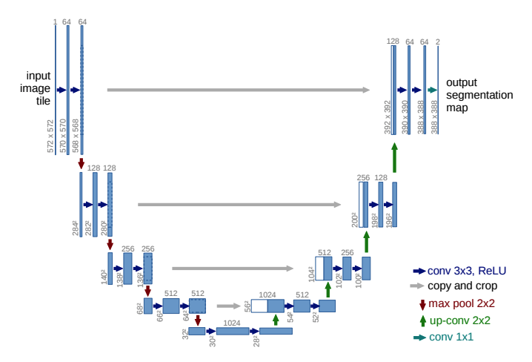
Model
Fastai example – implements the circled are w ResNet – but the underlying architecture is selectable
Model is Unet:
Makes smaller to generalize then expands to estimate which pixel is which class.
Implemented here w ResNet but other architectures can be tried out
Notes:
Valid.txt contains the image file names to hold for validation set:
0016E5_07959.png
0016E5_07961.png
0016E5_07963.png
0016E5_07965.png
…

Slide 29
Models: U-Net segmentation is different from segmentation used in PAIV
Detectron (used in PAIV )
Based on modified versions of region proposal methods culminating in Mask R-CNN
Practical implication is that for PAIV, the result is a set of polygon vertices and classes for the polygons
Each object is its own instance
Using vertices it is easy(ish) to do math computations on locations, areas, orientations of objects
Label with Polygons
U-Net (Semantic Segmentation/ Pixel classification)
Also uses Masks but the goal is to classify each pixel as belonging to one class or another
Practical implication is that result is a mask and a score indicating which class each pixel belongs to.
Each object is not its own instance – two bicycles in image will likely be assigned to the same class
So this is great for image composition – seems like location and polygon boundaries will take extra s
Steps
Label with a mask editor (pixel editor)

Slide 30
Methodology
Start w smaller resolution images
Transfer learning to start
Determine best learning rate : fit_onecycle
Goes from smaller to bigger resolution images
Unfreeze: more layers to custom fit
Use learning rate finder and heuristics to choose proper learning rates at each stage

Slide 31
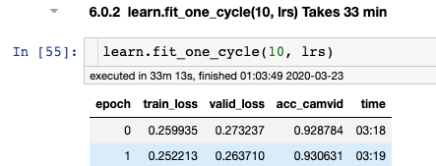
Results:
Fastai
Original Paper

Slide 32
Thankyou! ☺

